Slide 1
Slide update

Slide 2
Data communication networks
Local Area Network (LAN)
Network systems in one geographical location
For example All systems within a building
Usually high speed high bandwidth
Modern networks typically Ethernet
100/1000Mb/s – 100BaseT/1GBaseT
Notes:
Explain:
Local area networks (LANS) are typically high speed, high bandwidth connections designed to allow components, computers and networking equipment, to communicate within a geographically close location. For example within a building or campus, collection of building on one site.

Slide 3
Data communication networks
Wide Area Network (WAN)
Designed to connect together networks over a large distance
Typically slow and smaller bandwidth than LANs
Routers usually connect LANs to create WANs
Links often through telecommunications companies
Handout 1
Notes:
Explain:
Students should ready be familiar with LANS as them to explain the key points on slide.

Slide 4
Data communication networks
Metropolitan Area Network (MAN)
Typically used by many different organisation
Geographically larger than LAN smaller than WAN
Sometimes publically owned
From a few buildings to entire cities/regions
Notes:
Explain:
Students will not have experienced the definition of MAN – explain the following
Metropolitan Area Network, MAN interconnects computers and resources in a medium sized geographical location, larger than a LAN but smaller than WAN. It would cover anything from a few building to entire cities and regions, for examples London. This MAN usually has moderate to high data rates (faster than WANs) and may be used by many different organisation or individuals. Sometimes a MAN is publically owned service.

Slide 5
Data communication networks
Packet Switched Telephone Network (PSTN)
Another name for the worlds telephone network
Sometime called Plain Old Telephone Service (POTS)
Owned by many organisation in many contrives
All interconnected for mutual benefit
Analogue rather than digital
Many different media types are used
Copper Cable
Fibre Optic
Undersea Cable
Cellular networks (Mobile)
Notes:
Explain:
Students will not have experienced the definition of PSTN– explain the following
Public Switched Telephone Networks (PSTN) is an aggregate of the world’s telephone networks. It is owned by many different companies in many different countries, however they are interconnected for the mutual benefit of all people so that voice and data communications can be sent to any area in the world that is connected to the networks. PSTN will include telephone lines, fibre optic tables, cellular networks and undersea cables.
.

Slide 6

Data communication networks
Packet Switched Data Network (PSDN)
Method of connecting data networks over large distances
Companies will ‘lease’ time from a provider - BT
Many WAN protocols used
X.25
Frame Relay
Asynchronous Transfer Mode (ATM)
Typically uses permanent virtual circuits (PVC)
Entire bandwidth available
Charged to ‘rental’ not on demand
Packet Switching – breaks messages into packet
Notes:
Explain:
Students will not have experienced the definition of PSDN
Point out that packet switching and circuit switching will be mentioned later and is often the key difference between LAN and WAN
Explain the following
Packet Switched Data Network (PSDN) is a technique used for connecting networks over large areas. Typically companies will ‘lease’ time from a provider (BT) and use a leased line to connect sites over geographical large areas. It is not part of the standard PSTN network. Many protocols have been used for this purpose in the past including X.25, Frame Relay,. The term Packet switched implies data is broken down into small chunks (packets) as opposed to circuit switching (dedicating one line for all traffic).

Slide 7
Data communication networks
Integrated Services Digital Network (ISDN)
Voice and Data over encoded digitally (not analogue)
Designed to carry voice with extra services
Dials-On-Demand
Charged as used
Creates a dedicate circuit switched network
As opposed to packet switched
Provides 64K channels
Combines channels for 128Kb/s up and down
Uses for
small business connections
Video conferencing
Notes:
Explain:
Students will not have experienced the definition of PSDN
Point out that packet switching and circuit switching will be mentioned later and is often the key difference between LAN and WAN
Ask what is the difference between analogue and digital. Digital encoding will be a major part in the next sections
Explain the following
Integrated Services Digital Network (ISDN) is a set of standards used transmit voice, video and data over traditional public switched telephone networks. Design primarily carry voice with addition services all combined into a single line. Both voice and data are encoded digitally however ISDN is circuit switched, one dedicated line transmits data as opposed to information being broken into packets. It provides channels of 64Kb/s and several channels we used to provide 128Kb/s both up and downstream. It has been used for internet connections for Small Businesses and still used for some video conferencing. Other technology is increasingly being used for this purpose for example (DSL) / Cable.

Slide 8

Data communication networks
Satellite
Connect a network to satellite in orbit then to WAN
Signals transmitted from ground to orbit
Normally used when are no other options
Remote location
High latency – signal delay
Low bandwidth – low b/s
High cost
Notes:
Explain:
Students – should have talked about satellite communication before
Identify key points – latency due to signal distance. High cost low bandwidth. Normally last resort communications.
Satellite networks are used to gain connect networks that typically have no other option, usually because of their remote location and lack of telecommunication provider alternatives. Access to satellites is gain via third part communications companies. Signals are transmitted to communications satellites in orbit around the earth and relayed back to a central location where they are typically connected to larger communications networks such as the internet.

Slide 9

Activity – Assignment Question 1
Complete question 1

Slide 10
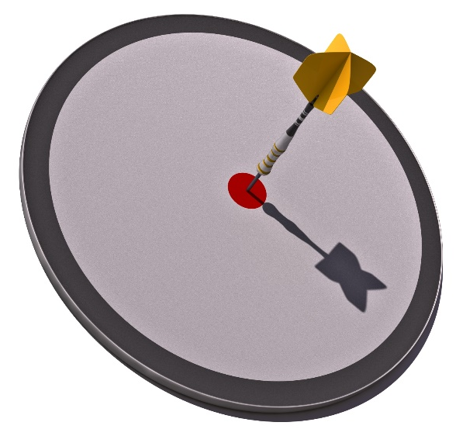
Objectives
Participants can explain:
Data transmission methods
Asynchronous and synchronous transmission
Discuss strategies for controlling errors

Slide 11
Data transmission methods
How signals are transmitted one way/both ways
Simplex
Semi-Duplex (Half Duplex)
Duplex
How signals are encoded in electrical signals
Unipolar
Return-To-Zero
Non-Return-Zero (NRZ)
Manchester
High density bipolar 3 (HDB3)

Slide 12

Data transmission methods – Transmission
Simplex
One way signal (unidirectional) – TV broadcast
Notes:
Trainees – should know this ask them to explain slide
Simplex communication is unidirectional information is sent but never returned. By analogy this would be like a television broadcast. Early serial communication used to send information to printers streamed information one way but had no way to send information back, for example to indicate a printer had run out of paper

Slide 13
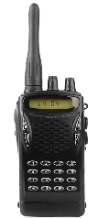
Data transmission methods – Transmission
Semi-Duplex
Both directions
Only one direction at a time
Used in bus transmission – thin Ethernet / hubs
Hello … over
Hi what is Semi duplex … over
Notes:
Trainees – should know this ask them to explain slide
Cover key points
Semi-Duplex is half duplex
Bus transmission – thin/thick Ethernet
Hubs (logical bus)
Semi-Duplex (Half Duplex) this allows two way communication but only one direction at a time. By analogy this would be like a walkie-talkie. Networks with hubs have to use allow half duplex communication.

Slide 14

Data transmission methods – Transmission
Full-Duplex
Both directions – at the same time
Switches support this
Twice as fast
Notes:
Trainees – should know this ask them to explain slide
Duplex – two way communication
Used by switching
There is no contention – other system trying to transmit so two way communication can take place

Slide 15

Data transmission methods
How signals are encoded in electrical signals
Unipolar
Return-To-Zero
Non-Return-Zero (NRZ)
Manchester
High density bipolar 3 (HDB3)

Slide 16
Data transmission methods
How signals are encoded in electrical signals
Unipolar
Return-To-Zero
Non-Return-Zero (NRZ)
Manchester
High density bipolar 3 (HDB3)

Slide 17
Data transmission methods
Unipolar
Voltage = +1
No Voltage = 0
0
0
Notes:
Most Basic Encoding

Slide 18
Data transmission methods
Bipolar - Alternate Mark Inversion
0 = No Voltage 1 = Alternate +ve/-ve
Avoids DC build up
1
0
1
0
0
1
Notes:
Stops the build up of DC (Average = 0 volts)

Slide 19
Data transmission methods
Non-Return-To Zero(NRZ)
Return-To-Zero (RZ) - returns to zero half way through
1
0
1
0
1
0
Return-To-Zero
Non-Return-To-Zero
Notes:
RTZ
Has advantages over NRTZ
It is self clocking
It is Positive for exactly ½ clock cycle – no need for additional signal
It uses half the power
Only at full power half the time compared to NRTZ

Slide 20
Data transmission methods
Manchester Encoding – 10BaseT (self clocking)
0
0
1
1
0
0
1
Notes:
Manchester encoding
0 = 1 – Followed by 0 half way through
1 = 0 – Followed by 1 half way through
This is a self clocking technique signal always changes half way through – no need for extra signal
This is the encoding scheme for 10BaseT IEEE 802.3

Slide 21
Data transmission methods
High Density Bipolar 3 Zeros (HDB3)
4th Zero replaced – to allow clocking
1 = +Voltage or –Voltage (alternating)
0 = No Voltage
1
1
0
0
0
0
Too many zeros
Notes:
HDB3
Explain:
1 can be +ve voltage or –ve voltage but if it alternates if that last 1 was +ve the next must be +ve
Prevents DC builds up – no average voltage
0 – Represented by no voltage
This causes a problem with clocking because there is no change in signal to time
Therefore the code is extended so after the 4th 0 more complex coding takes pace

Slide 22
Data transmission methods
Count number pulses since violation (X)
Count number of minuses since violation (Y)
Is X-Y odd / even
Number of +/- bits | Pattern | Polarity | Coded
since last V |  | of last Pulse
odd | 000V | + | 000+
 |  | − | 000−
even | B00V | + | −00−
 |  | − | +00+
Notes:
HDB3
Explain:
High density bipolar 3 (HDB3) encoding is an extension of (Alternate Mark Inversion) encoding. This represents a 1 one by transmitting a pulse of positive, negative and represents a 0 as no pulse. AMI however of it transmits many zeros has no transitions and therefor it is becomes difficult to self-clock. To alleviate this HDB3 uses AMI but should there be more than four zero’s the fourth zeros is considered a violation bit and the following rules are followed to encode the data:
Every time there are 4 consecutive zeros in the code they will be replaced by either 000−, 000+, +00+ or −00−. To determine which pattern to use,
Count the number of pluses positive pulses since the last violation bit
This number is (x)
Count the and the number of minuses since the last violation bit
This number is (y)
If x-y is odd number then
A code of either 000+ or 000- is used
If x-y is even then then
A code of either +00+ or -00- is used.
The polarity is defined by the pulse preceding the four zero’s, if it see the table below.

Slide 23
Activity – Assignment Question 2
Complete question 2

Slide 24

Objectives
Participants can explain:
Data transmission methods
Asynchronous and synchronous transmission
Discuss strategies for controlling errors

Slide 25

Asynchronous and synchronous transmission
Synchronous
Local and Remote synchronise their timing clocks first
Large block of data sent at agreed rate
Good for transmission of large blocks of data
It takes time to create the connection
ISDN, PATA, are synchronous
Notes:
Explain
This is a method of transmitting information where a clock signal is used to make sure that information is transmitted at a steady predefined rate (pre define baud rate), hence it is synchronises. The rate of transfer typically much higher than the alternative. X.25 and Frame Relay communication use this method of transmission. At smaller scale computer parallel communication such as Centronics parallel IEEE 1284 and older PATA hard disk links. This is ideal where large amounts of data need to be transferred between two locations. Data is typically built into large blocks.

Slide 26
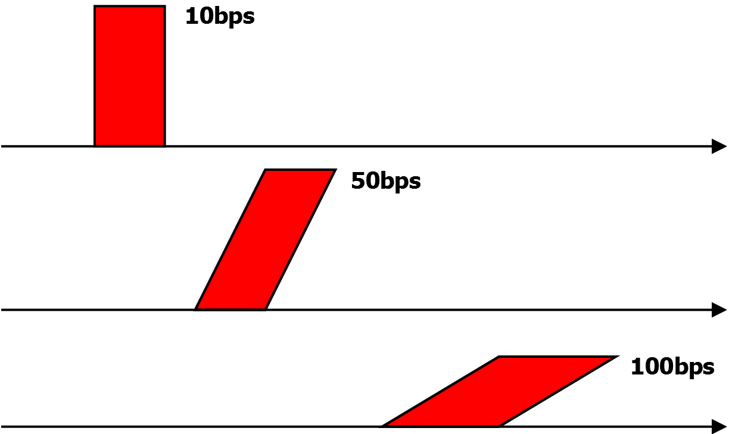
Asynchronous and synchronous transmission
Asynchronous
No clock synchronisation at start
Small amounts of data sent (characters)
Can be sent at varying speeds
Slower for large blocks
Sent character at time
Notes:
Explain
This method of transmitting data has not clock signal and may transmit information at varying rates and with large gaps between one piece and the next. As communication isn’t timed there needs to be a signal at the start of the data and the end of the data to define the start and end points. These are often implemented using start and stop bits. Most serial communication such as RS-232 and Asynchronous Transfer Mode (ATM) use this method of communication.

Slide 27
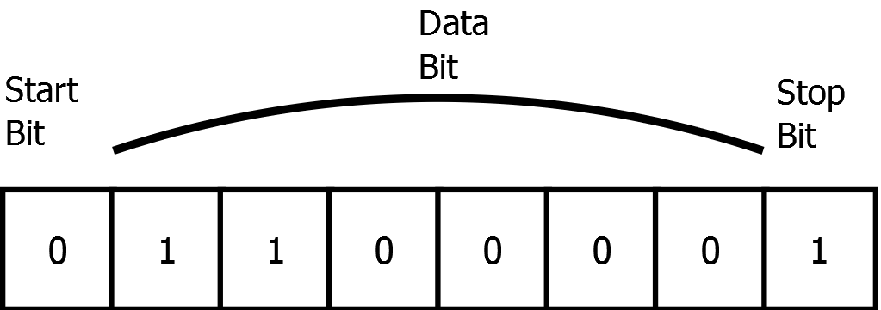
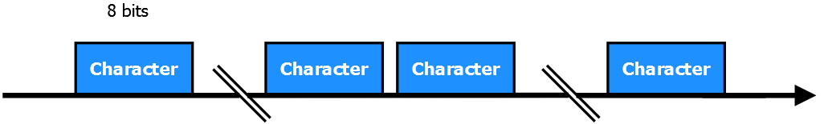
Asynchronous and synchronous transmission
Asynchronous
Start and stop bits used for timing
There may be parity included
ATM, ADSL and Serial use this method
Notes:
Explain
That data is delivered at varying rates so there are short busts of information and no clock. The start and stop bits help mark out the beginning and the end of each 8 bits (character). Most network traffic is ‘bursty’

Slide 28
Activity – Assignment Question 3
Complete question 3

Slide 29
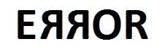
Module 2 - Objectives
Participants can explain:
Data transmission methods
Asynchronous and synchronous transmission
Discuss strategies for controlling errors
Notes:
Explain that none of the strategies so far correct errors they only detect them

Slide 30
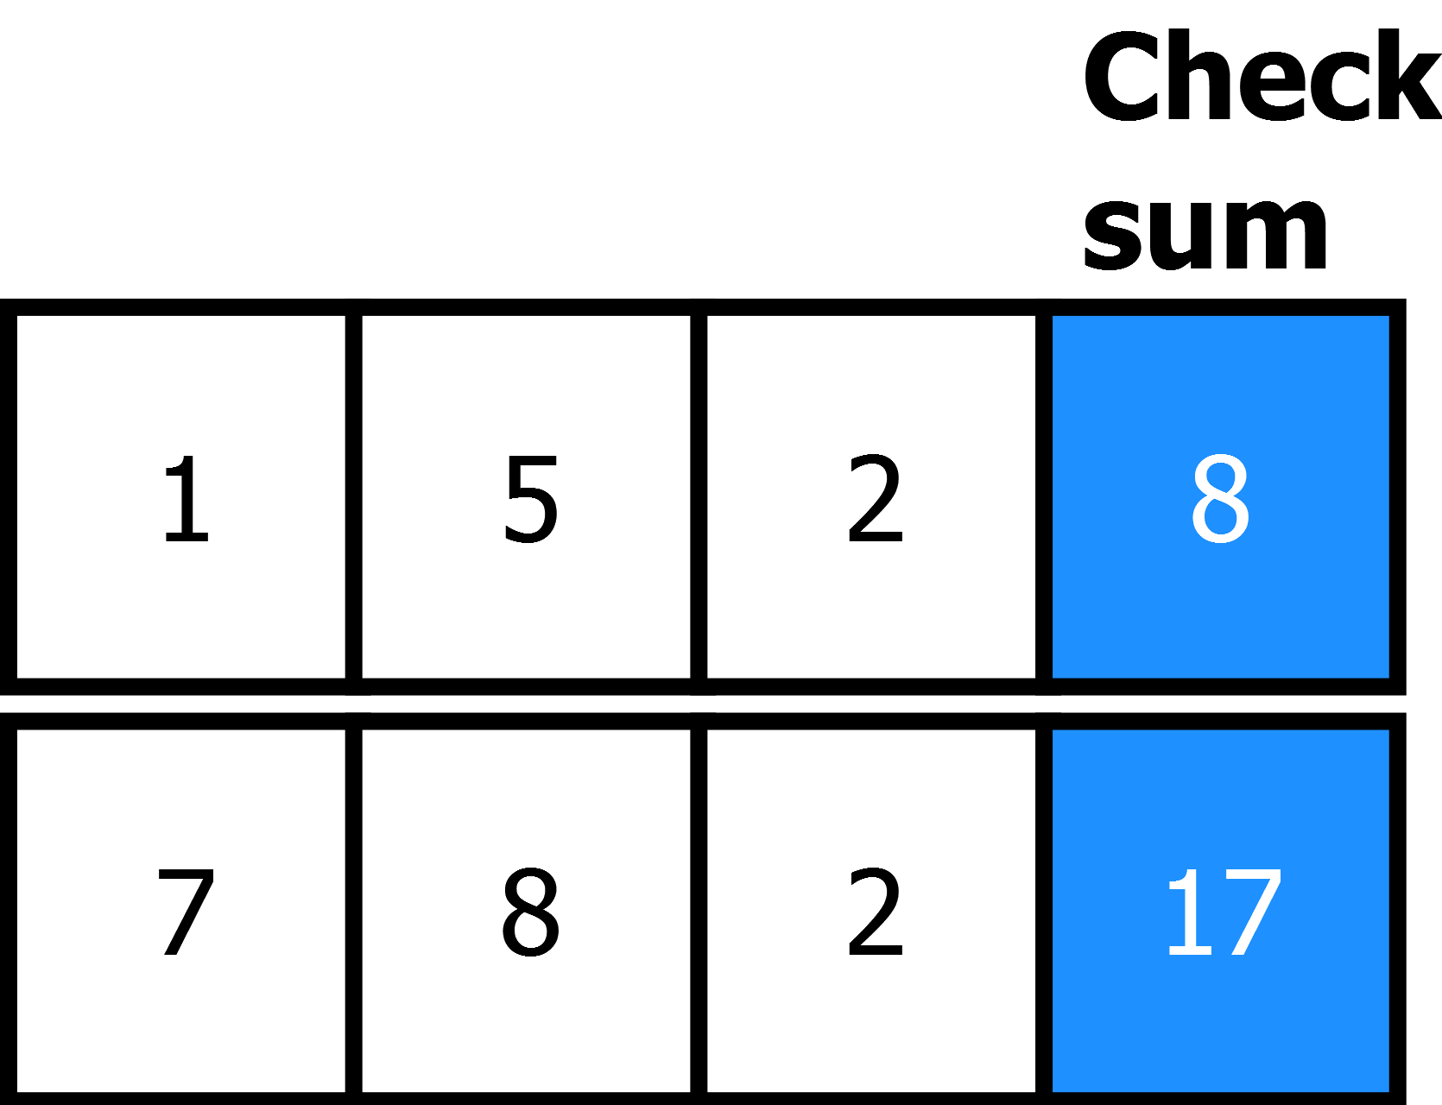
Discuss strategies for controlling errors - detection
Checksum
Add together sequences of bytes - checksum
Can be more complex algorithm
Calculated by sender and receiver difference = error
This is a hash – not a secure one
Notes:
Explain
Checksum: Is a way to generate a number using a mathematical algorithm on data to be transmitted. The number that is generated is often called a hash. For example of the numbers 1,2,5 were transmitted then a very simple checksum would be to add all the number together (8) and this would be transmitted at the end of the message. Should the signal be transmitted but corrupted for example 1,0,5 then the check sum of 8 would not match the data at the receiving end. Therefore the receiving device would detect that data has been corrupted. The example of a hash would not be used in the real world because it could be manipulated easily by potential hackers to deceive a receiving device that a message has not been change when in reality it has. Stronger standard hashes used for checksums in the real world are SHA-256 and MD5.

Slide 31
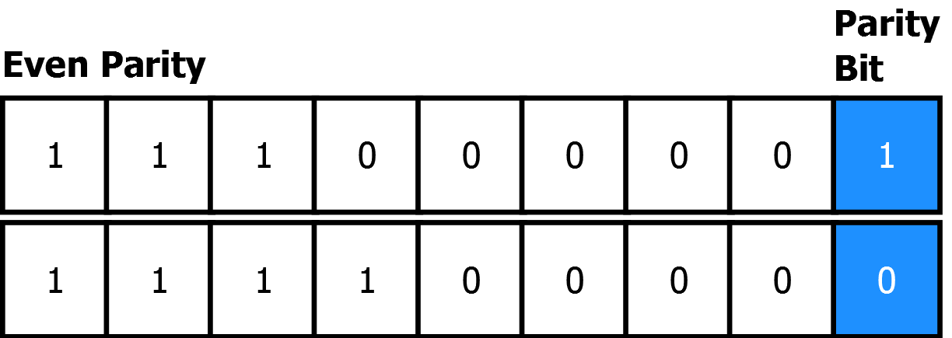
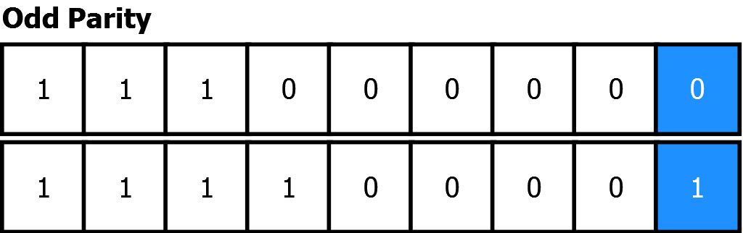
Discuss strategies for controlling errors - detection
Parity
Count the number of 1’s sent
Even parity – add ‘1’ to make even
Odd parity – add ‘1’ to make odd
Notes:
Parity: Parity is the use of an extra bit in communication which either ensures that there are an even or odd number of ‘1s’ in transmission. For example with even parity if 01010100 was transmitted there would be an 3 and there for uneven number of 1’s, an additional ‘1’ is added at the end so that there is an even number of ‘1’. If there is an even number of 1’s then a ‘0’ is added. This guarantees there will always be an even number of bit no matter what message is sent. Should the signal be corrupted during transmission then it is likely that the parity will be violated and this can be detected by the receiving device. The data can then be re-transmitted. The down side of this system is that if two bits are corrupted then it is not possible to detect the corruption.

Slide 32
Discuss strategies for controlling errors - detection
Cyclic Redundancy Check (CRC)
Improves on checksum – can be fooled/hacked
Creates a 32-bit number from block of data
Detects burst errors (errors at start and end)
Most internet traffic is burst

Slide 33
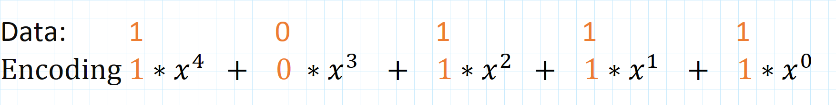
Discuss strategies for controlling errors - detection
Cyclic Redundancy Check (CRC)
Many CRC strategies including CRC16, CRC32
Small change in data large change in CRC
Adds up whole message as large number
Divides by another number
The remainder is CRC
Fixed length
Encodes data as polynomials
Notes:
Cyclic redundancy checks: Is an error detection code which takes blocks of data and appends a check value (a checksum). CRC therefore adds redundant data to the end of a block of data with the purpose of detecting errors. CRC creates fixed length checksum using specific mathematical functions created by Define and involves the use of a generator polynomial (generator equation). CRC-32 is a common standard used in networking including Ethernet. CRC are good for detecting burst errors where the start and end symbols are corrupted and the middle stream data has also at some points been corrupted. This is a typical type of error that occurs with hard disk and network traffic (Ethernet). X is an arbitrary number chosen so a small change in data makes a large change in CRC

Slide 34
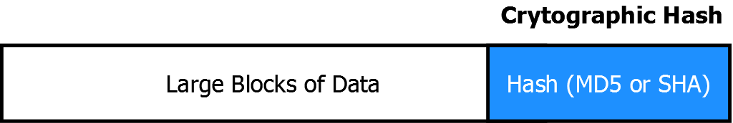
Discuss strategies for controlling errors - detection
Cryptographic Hash Function (Message Digest)
Mathematical algorithm - SHA, MD5
Impossible to regenerate data from hash
Creates a unique code that can only be from this data
Detects nearly all errors
Notes:
Explain
Cryptographic Hash Function: Take a block of data and generate a fixed length set of bits which are very likely to unique to that block of data. This set of bits is often called a message digest. Common algorithms used for hashes include MD5 and SHA. Data from a sending device has the message digest appended to the end of a transmission. At the receiving end the data is used to regenerate the message digest and if his differs from the one sent by the sending device then there has been corruption of data. Cryptographic Hash Functions and also used to detect malicious tapering of a data stream.

Slide 35
Activity – Assignment Question 4
Complete question 4

Slide 36
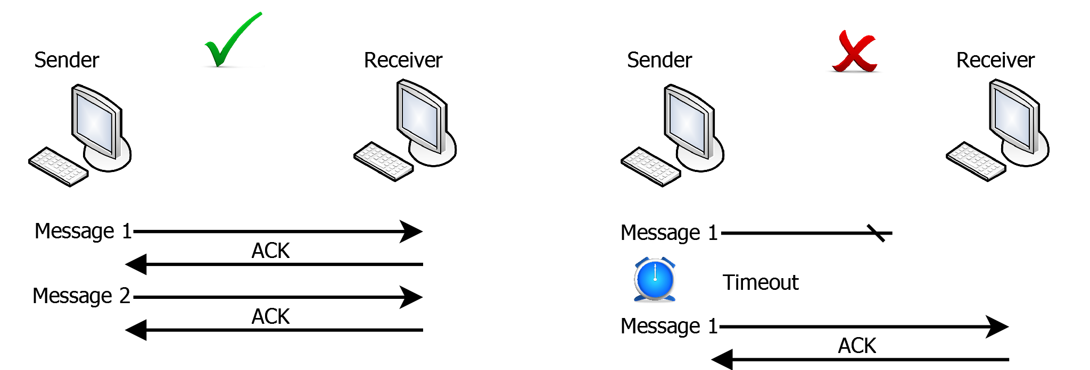
Automatic Repeat Request (ARQ)
Receiver sends acknowledgment (ACK) – arrived
Sending device waits for ACK – resends if not received in time
Notes:
Explain – diagram
Message 1 sent and acknowledged
Message 2 sent and sender timeout expires – message 2 send again and is this time acknowledged
Automatic Repeat Request (ARQ) – Is a method of handling the loss or corruption of messages to ensure that ultimately the message received is error free. This method uses acknowledgements, a message sent by the receiving device that informs the sender that the message has been received intact. Should the sender not detect an acknowledgement within a specific time the last set of data is re-transmitted. There is a way of guaranteeing a message will be sent uncorrupted even when the lines over which the message sent is not reliable. There are several methods of ARQ including idle and continuous ARQ

Slide 37
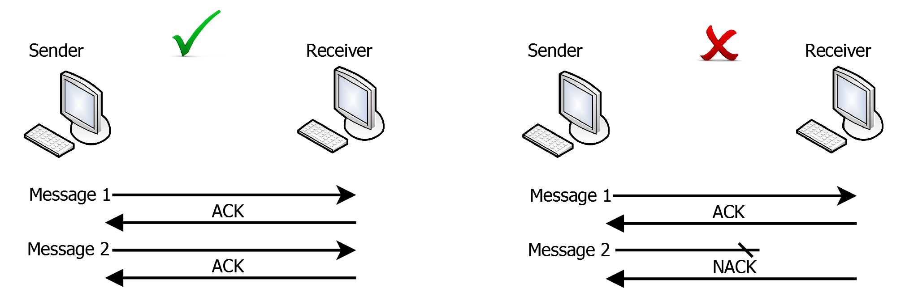
Stop and Wait (idle) Automatic Repeat Request
Sender – returns acknowledgement (ACK) for success
Sender – returns no acknowledgement (NACK) failure
Not efficient – may be large waits for NACK/ACK
Notes:
Explain – diagram
Message 1 sent and acknowledged
Message 2 sent and this time receiver sends NACK (not clock)
Stop and Wait (idle) Automatic Repeat Request: Is a specific type of ARQ where a block of information (Protocol Data Unit) is sent and the sender then waits for an acknowledgement (ACK) or a negative acknowledgment (NACK) before sending the next block of data. This is a simple mechanism but is not efficient because the sending system can spend long periods waiting for ACK/NACK’s when it could be transmitting data.
There are further schemes which wait for several requests to be sent and then acknowledge
This is where windowing is used
Also each message number has to be tracked so that the one ACK points to one message

Slide 38
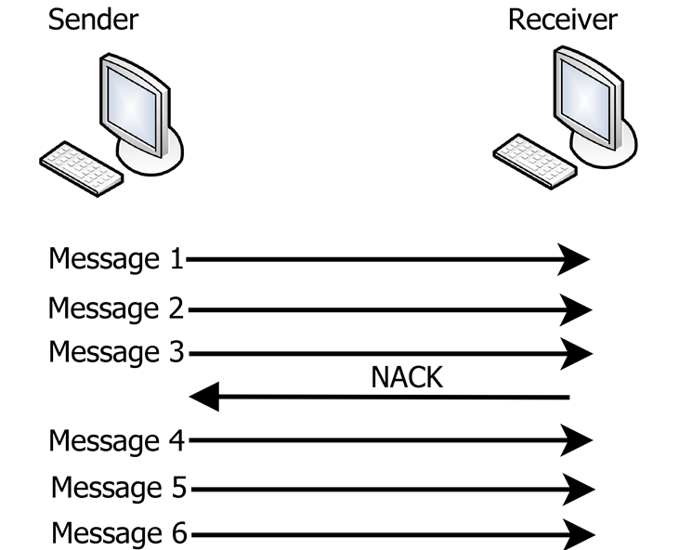
Continuous Automatic Repeat Request
Constant stream of messages
Stream stops (NACK) from receiver
Stream restarts
Requires full duplex
More efficient
No need to wait for ACK
Notes:
Explain – diagram
Messages sent and until NACK – Then restarts
Continuous Automatic Repeat Request: Is a specific type of ARQ that requires full duplex communication. A constant steam of information is sent to the receiver until a negative acknowledge (NACK) is sent from the receiver to the sender. The benefit of this type of ARQ is that time is not wasted waiting for an ACK before more data is sent.

Slide 39
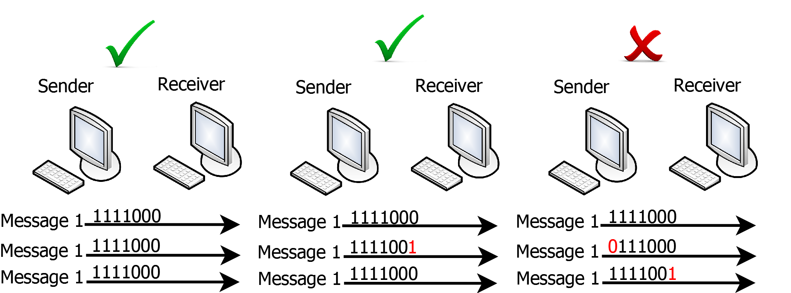
Forward Error Correction
Duplicate information sent
Simplest code reputations - FEC (3,1) - 3 copies sent
If two or more match – use them
Majority voting system
Notes:
Explain – diagram
Message send three times – if two match use the matching messages
If all different resend
Forward Error Correction: Is a method of controlling errors by duplicatng transmission of data and allows for recovery. Duplicated data is send which means that if one set of data is corrupted the information can be recovered from the other (redundant sets). For example the simplest type of FEC is achieved by sending data three times know as a (3,1) repetition code. All three sets of data are inspected and should there be a difference between them the two copies of that agree are used as the final data. This could be considered a majority voting system.

Slide 40
Activity – Assignment Question 5
Complete question 5
Notes:
and spelling must be applied

Slide 41
Objectives
Participants can:
Describe LAN topologies and transmission media
Describe methods of media access control for LANs
Describe the IEEE 802 standards for LAN classification
Describe the function of LAN hardware

Slide 42

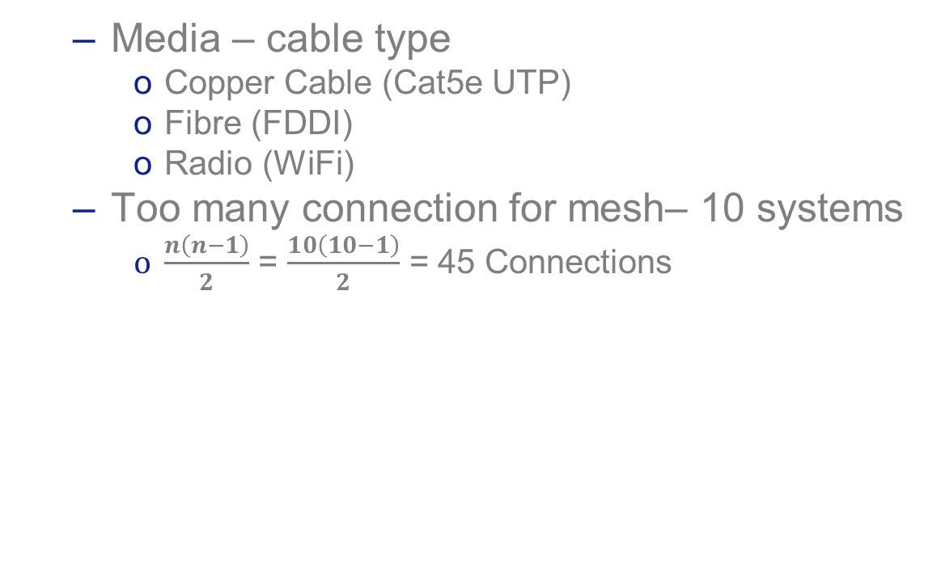
Media access control
Media – cable type
Copper Cable (Cat5e UTP)
Fibre (FDDI)
Radio (WiFi)
Too many connection for mesh– 10 systems
$\frac{n\left(n−1\right)}{2}$ = $\frac{10\left(10−1\right)}{2}$ = 45 Connections
Notes:
Explain
When there are 10 systems then 45 connection are needed to connect all systems to all other systems. Then this grows to 100’s the amount of connections becomes impractical (4950). There are several solution to this.

Slide 43
Media access control
Shared medium – large number of connections
Access to shared media managed
To stop corruption
Requirement for media access control
Round Robbing – Polling, Token
Contention – Aloha, Slotten Aloha, CSMA/CD, CSMA/CA
Notes:
Explain

Slide 44
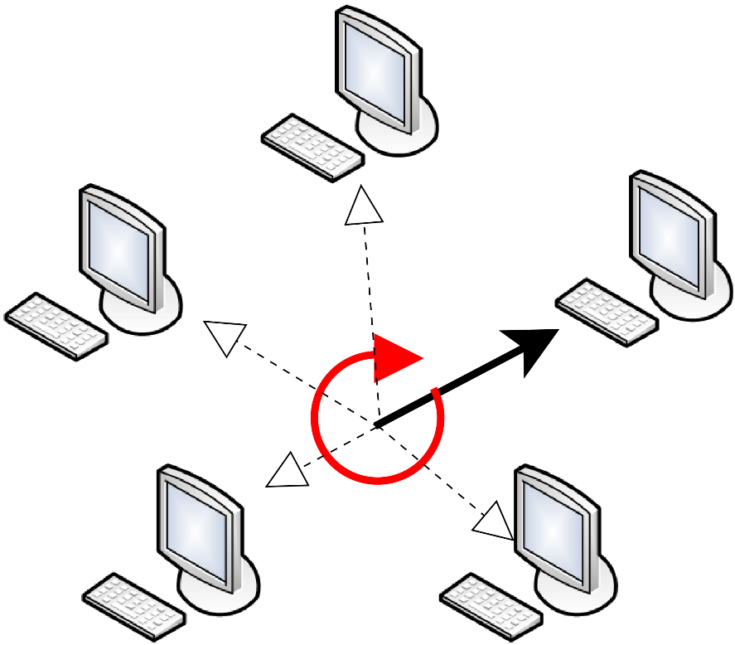
Media access control – Round Robin
Polling
Each system – polled in turn
Very inefficient for ‘bursty’ traffic
Random, short blocks
Poor method for networks
Notes:
Explain
Polling: This is the simplest way to grant systems access to a shared medium (line). Typically a centralised controller checks connects to each node in turn if it wants to send data. If it does then it is granted access to the medium (wire). Once the node has finished the then goes to the next device in turn. Once all devices have been ‘polled’ then the process repeats connecting to the first device in the series. Polling is simple to design but becomes inefficient when there are random bursts of information, this is typical in most data networks.

Slide 45
Media access control – Round Robin
Token – Specially formatted Packet
Token Ring – token passed to next system 802.5
Token Bus – token released & taken on demand 802.4
Notes:
Explain
Token Passing: In token passing schemes the nodes are connected have shared access to a medium is. Access is granted when a node receives a token, a specially formatted packet of data. When a device has the token it and transmit and receive information, when it is finished the token in then release for another system to hold. In the case of token ring systems are logically connected in a ring one node to another and releasing the token simply means passing it to the next node in the ring. In the case of token bus the token is transmitted on a shared wire (bus) a system takes the token when it is ready to transmit information.

Slide 46
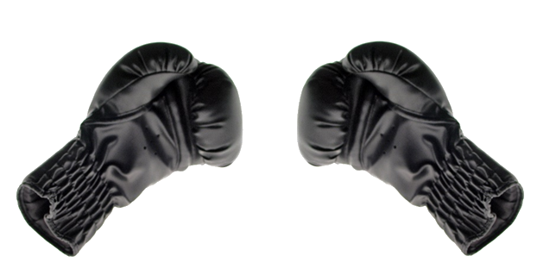
Media access control – Contention
Fight for access to media
Bus – Copper Wire
Wifi - Radio
Several schemes
Aloha, Slotted Aloha
CSMA/CD
CDMA/CA
Notes:
Explain
Contention is when many systems fight for access to a shared medium such as a copper cable. If two systems transmit at the same time then the signal become corrupted. There have been several schemes devised to manage this.

Slide 47
Media access control – Aloha
Created by Hawaii University
Basis of other contention systems
Designed for central mainframe computer
Free-for-all over radio
2 Frequencies
Transmit Frequency – Channel 1 – Sending Nodes
Receive Frequency - Channel 2 – Mainframe rebroadcast
Nodes check what was sent back not corrupted
Notes:
Explain
Aloha: This was created in Hawaii to transmit packet of data across a radio network from a remote systems to a central computer. Two frequencies were used the first to transmit the data, the second frequency was used by the central computer to broadcast all messages sent. Sending nodes could then check if the signal had been transmitted without error or if another computer had corrupted the data by transmitting at the same time (termed a collision). This was a free-for-all network every node transmitting whenever it needed to without regard other nodes on the network. This was inefficient.

Slide 48
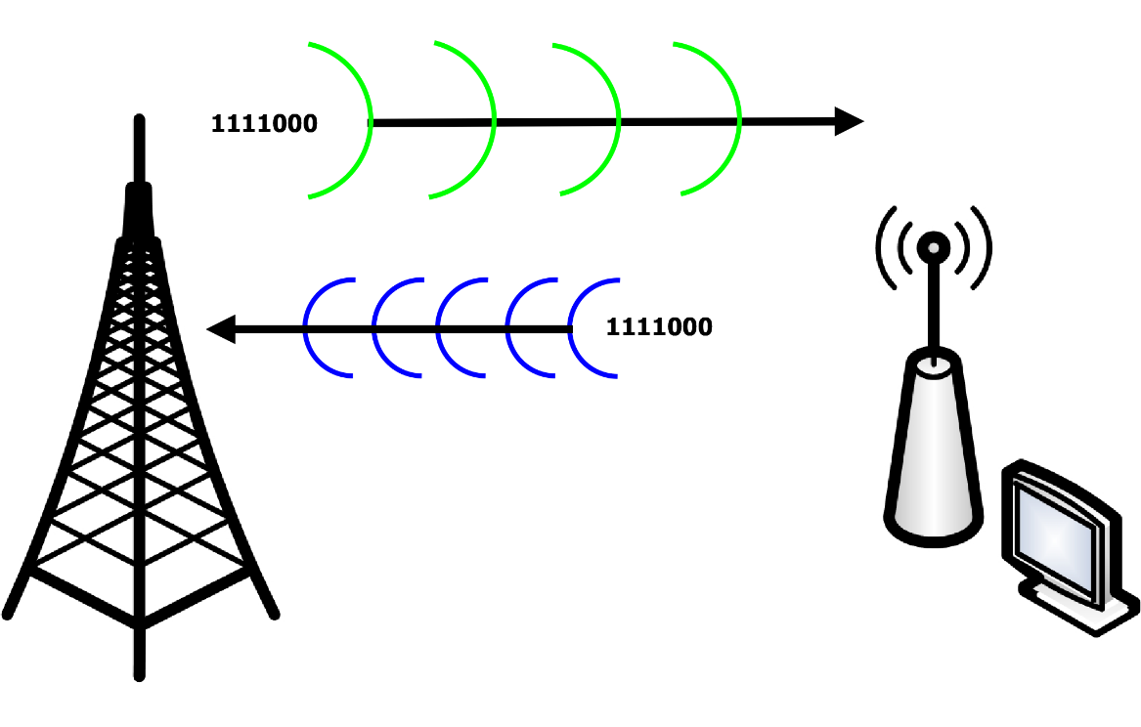
Media access control – Aloha
Signal sent from client
Signal returned from mainframe
Notes:
Explain
Aloha: This was created in Hawaii to transmit packet of data across a radio network from a remote systems to a central computer. Two frequencies were used the first to transmit the data, the second frequency was used by the central computer to broadcast all messages sent. Sending nodes could then check if the signal had been transmitted without error or if another computer had corrupted the data by transmitting at the same time (termed a collision). This was a free-for-all network every node transmitting whenever it needed to without regard other nodes on the network. This was inefficient.

Slide 49
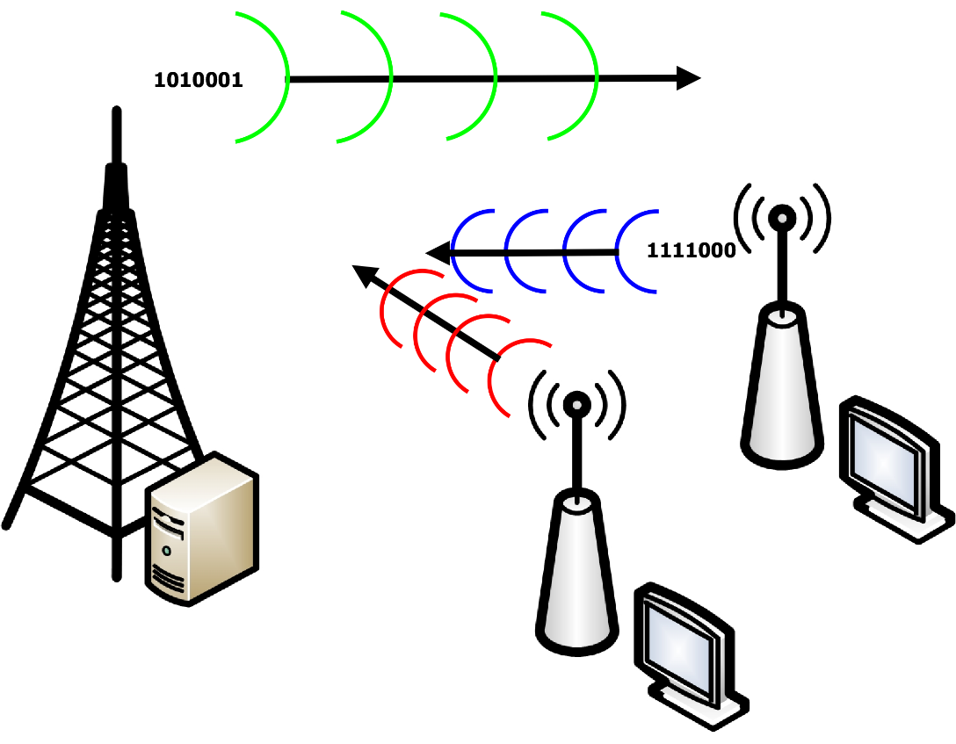
Media access control – Aloha
Two systems transmit – collision
Resend does not match
Notes:
Explain
Aloha: This was created in Hawaii to transmit packet of data across a radio network from a remote systems to a central computer. Two frequencies were used the first to transmit the data, the second frequency was used by the central computer to broadcast all messages sent. Sending nodes could then check if the signal had been transmitted without error or if another computer had corrupted the data by transmitting at the same time (termed a collision). This was a free-for-all network every node transmitting whenever it needed to without regard other nodes on the network. This was inefficient.

Slide 50
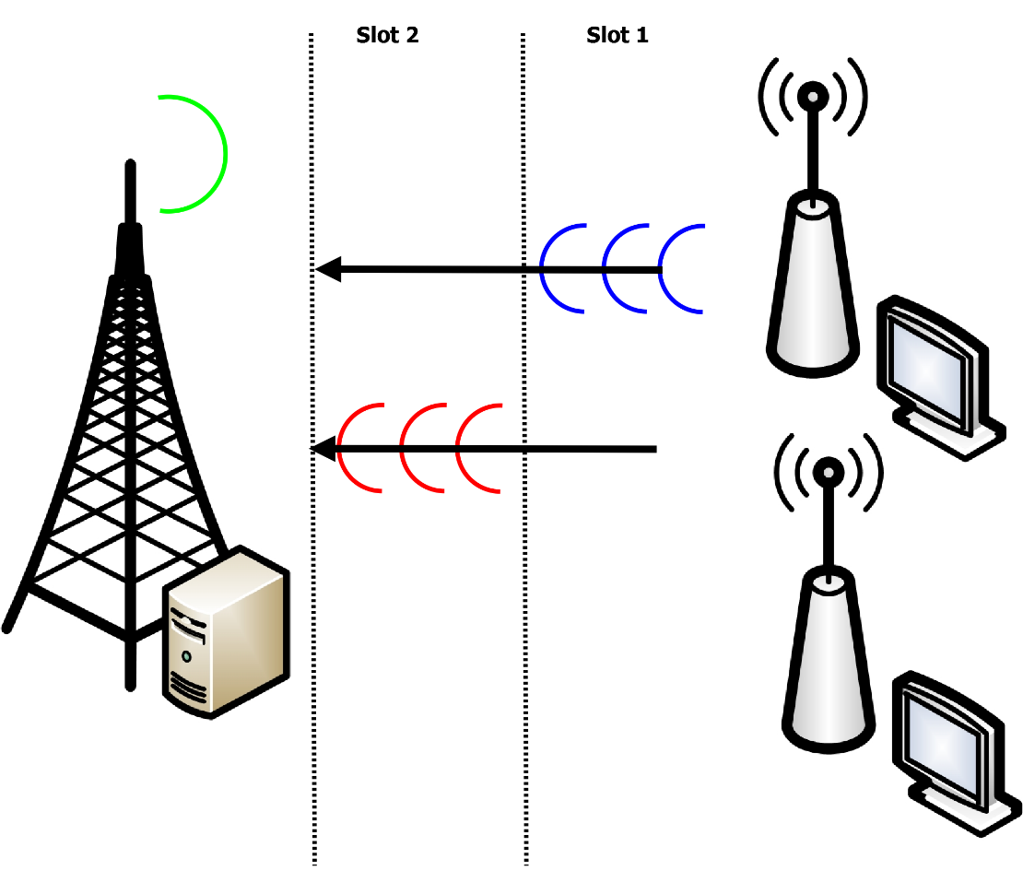
Media access control – Slotted Aloha
Time slots allocated
Less chance of collision
Re-broadcast from mainframe
Collisions still happen – less frequent
Notes:
Explain
Slotted Aloha: Was based on Aloha with one major modification. Available time was broken up into time slots of a fixed length. These slots were of a fixed size and nodes could only transmit at the start of a time slot. This reduced the likelihood of a collision

Slide 51
Media access control – Carrier Sense Multiple Access/CD
Improvement on Aloha
Nodes listen – wait till quiet
Collision detect
Two nodes start to transmit after quiet
Whole signal from both nodes corrupted
CD – Detects collision as soon as it happens
2 Nodes wait a random time
Much more efficient
Used in Bus technologies 802.3
Notes:
Explain

Slide 52
Media access control – Carrier Sense Multiple Access/CA
Collision Avoidance (CA)
Used in Radio 802.11 (a,b,g,n, AC)
Designed to have advantages of CSMA/CD plus
Hidden station problem
Exposed station problem
Notes:
Explain

Slide 53
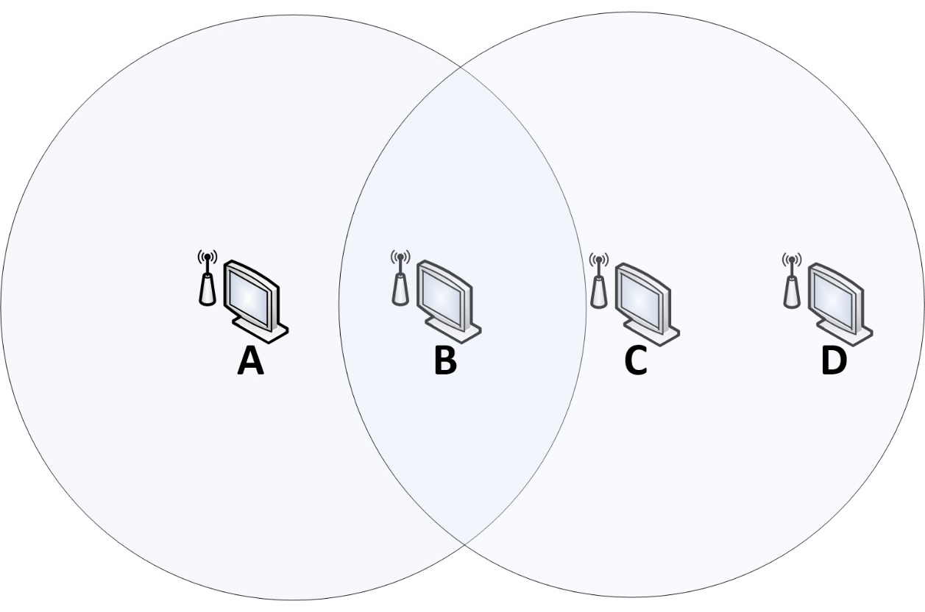
Media access control – Carrier Sense Multiple Access/CA
Hidden workstation
A is transmitting to B but A is out of range of C
C incorrectly assume no data transmission
Notes:
Explain
Collision Avoidance uses the following steps. It listens before sending, if someone else is transmitting then it will wait a random time. If no one is transmitting then a Ready-to-Send (RTS) message is sent embedded with the destination address. Other nodes know that they must wait before transmitting. The destination sends a Clear-To-Send message (CTS). This informs the sender that it can start transmitting without fear of a collision. Following this packets of data are transmitted and acknowledgement send (ACK). Should an acknowledgement not be received the packet is re-transmitted.

Slide 54
Media access control – Carrier Sense Multiple Access/CA
Hidden workstation
A is transmitting to B but A is out of range of C
C incorrectly assume no data transmission
C transmits to B causing a collision.
Collison
Notes:
Explain
The ‘hidden station’ is explained by the above. A is transmitting to B but is out of range of C. If C senses the media then it will incorrectly assume no there is no data transmission (because A is out if range). C will then transmit to B causing a collision.

Slide 55
Media access control – Carrier Sense Multiple Access/CA
Exposed workstation
if B transmits to A, C will falsely assume it cannot transmit to D.
C can talk to D because A is out of range.
Ok but wrongly assumed
invalid
Notes:
Explain
The exposed station problem is demonstrated on the same diagram, if B transmits to A, C will detect this and falsely assume it cannot transmit to D. C can in fact talk to D because A is out of range.

Slide 56
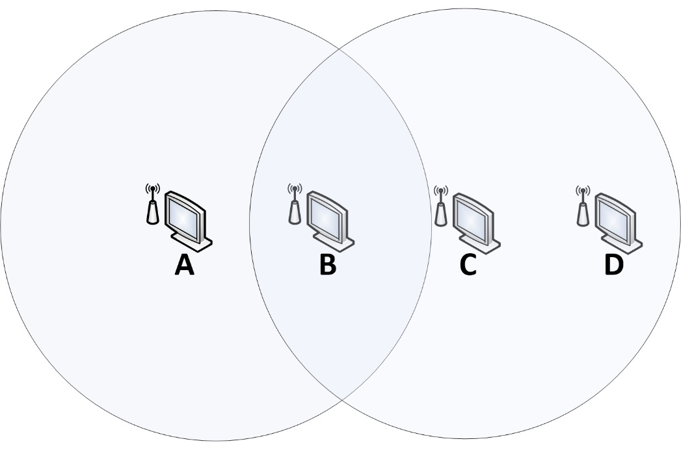
Media access control – Carrier Sense Multiple Access/CA
CSMA/CA – Detects these
Listen wait random time if busy
When free sends “Ready-To-Send”
Node destination inside
Nodes warned – about to send
Destination “Clear-To-Send”
No chance of collision
Packets Sent
ACK returned
Resent if lost
RTS
CTS
Notes:
Collision Avoidance uses the following steps. It listens before sending, if someone else is transmitting then it will wait a random time. If no one is transmitting then a Ready-to-Send (RTS) message is sent embedded with the destination address. Other nodes know that they must wait before transmitting. The destination sends a Clear-To-Send message (CTS). This informs the sender that it can start transmitting without fear of a collision. Following this packets of data are transmitted and acknowledgement send (ACK). Should an acknowledgement not be received the packet is re-transmitted.

Slide 57
Activity – Assignment Question 6
Complete question 6

Slide 58
Objectives
Participants can:
Explain features of wide area networks (WANs)
Explain switching and packet techniques used in WANs
Explain how routing is achieved
Discuss the methods used for data communication over PSTN

Slide 59
Objectives
Participants can:
Explain features of wide area networks (WANs)
Explain switching and packet techniques used in WANs
Explain how routing is achieved
Discuss the methods used for data communication over PSTN

Slide 60
WAN Topologies – Point-to-point
Topology – how WAN’s connected together
All use routers
Simplest point-to-point
Cheapest
No redundancy
Notes:
Explain
Point-to-point is connecting two sites together. Can be connected using dedicated lease lines (expensive but guaranteed bandwidth) or using VPN over the internet, cheap but bandwidth not guaranteed.

Slide 61
WAN Topologies – Hub and spoke
Each branch office spoke
Connected to head office (hub)
All connected via routers
Cheaper
No redundancy
Notes:
Explain
Hub and spoke using same underlying links as point-to-point, however now many offices connect to one central site. Therefore all traffic must go through the hub, in this case London. For example to transmit information from Leeds to Bristol all information must go through the hub, London and visa versa. This is a very common setup for organisation.

Slide 62
WAN Topologies – Full Mesh
All offices connected to others
Redundant links
Expensive
Notes:
Explain
Full mesh uses the same underlying links as point-to-point, however now all offices have a link to all other offices. So that each site has four outbound connections. This means there is both a direct link to another site, for example Bristol is connected directly to Manchester. It also means there are many indirect alternative routes for example Bristol can communicate to Manchester through Leeds. This provides redundancy, alternative routes should one link fail. Because of the number of lines this is expensive.

Slide 63
WAN Topologies – Partial Mesh
Many links
Redundant links
Not All-to-All
Less expensive
than full mesh
More resilient than hub and spoke
Notes:
Explain
Partial mesh uses the same underlying links as point-to-point, however now all offices one or more links. This is a half-way-house to a full mesh, cheaper but still with some redundancy. For example Birmingham has two routes out whereas Bristol has 3.

Slide 64
Activity – Assignment Question 7
Complete question 7

Slide 65
Public Data Networks – Packet Switched Data Network
Designed for Data not voice
Site-to-site switching done for you
By telco (BT) (MPLS)
Connect each site to cloud
No need for mesh
Redundancy handled for you
Notes:
Explain
Packet switched data networks for example BT’s Multi-Protocol Label Switching allows connection to WANS through PSDN. A permanent virtual circuit is created between each site to be connected. Once created this remains in place even if there is no data travelling down the connection. Because of this users are charged for the time they use the system not on demand. There is a guaranteed bandwidth available at all times.

Slide 66
Public Data Networks – Packet Switched Data Network
Each Offices connects via network device
Usually router
Cloud handles all other routing
Each office connects to nearest
Point of Presence
May need a leased line
Can be cheaper than other WANS
Notes:
Explain
Each office is connected to the nearest Point-of-Presence an access point provided normally by a telco (for example BT). All other offices are connected to their local point-of-presence. The nearest point that can be used to access the PSDN cloud from the telco. This connection may need a dedicated leased line. PSDN can be cheaper than maintaining a WAN which may need multiple redundant links.

Slide 67
Public Data Networks - ISDN
Integrated Services Digital Network (ISDN)
Voice and Data over encoded digitally (not analogue)
Designed to carry voice with extra services
Dials-On-Demand
Charged as used
Creates a temporary dedicate circuit switched network
As opposed to packet switched
Provides 64K channels
Combines channels for 128Kb/s up and down
Uses for
small business connections
Video conferencing
Notes:
Explain:
Students will not have experienced the definition of PSDN
Point out that packet switching and circuit switching will be mentioned later and is often the key difference between LAN and WAN
Ask what is the difference between analogue and digital. Digital encoding will be a major part in the next sections
Explain the following
Integrated Services Digital Network (ISDN) is a set of standards used transmit voice, video and data over traditional public switched telephone networks. Design primarily carry voice with addition services all combined into a single line. Both voice and data are encoded digitally however ISDN is circuit switched, one dedicated line transmits data as opposed to information being broken into packets. It provides channels of 64Kb/s and several channels we used to provide 128Kb/s both up and downstream. It has been used for internet connections for Small Businesses and still used for some video conferencing. Other technology is increasingly being used for this purpose for example (DSL) / Cable.

Slide 68
Activity – Assignment Question 8
Complete question 8

Slide 69
Switching and packet techniques
Circuit switching
Creating a physical circuit and sending all traffic over that circuit
Packet Switching
Virtual Circuit – setup a route break up data into chunks (packets)
Datagram – break data into chunks (packets) each packet can travel a different route
Notes:
Explain

Slide 70
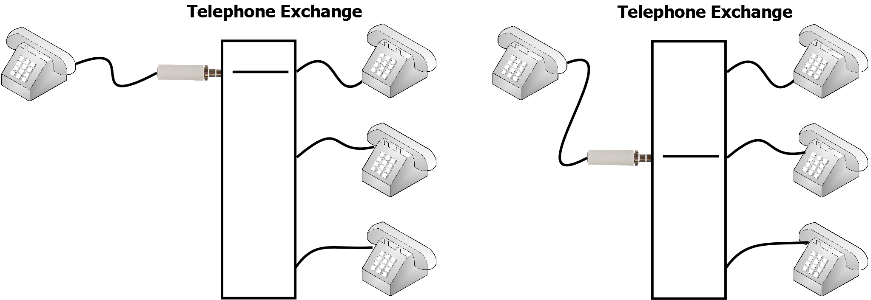
WAN – Circuit switched Networks
Physical circuit created – all bandwidth two systems
Circuit created at physical layer
Integrated Digital Services Network (ISDN) – Digital Services
Public Switched Telephone Network (PSTN) – Telephone System
Spare bandwidth not used
Notes:
Explain
Circuit Switching: This is the type of switching that is used for telephone lines (PSTN) and integrated digital services (ISDN). In circuit switching a dedicate communication path between switch nodes is defined before between two end devices. Therefore a physical, electrical network path must be created between the source and destination before any network traffic can flow. This path is called a circuit and remains unchanged for the duration of the communication and terminated at the end of the communication. Circuit switched networks allow for easy allocation of a guaranteed bandwidth, but not for re-routing of traffic in the case of failure. Bandwidth however may be wasted because of there is no flow of traffic between the source and destination, it is not allocated for other uses. One type of circuit-switched public data network (CSPDN), which transports data on circuit-switched networks using the X.21 protocol. Other protocols used on Circuit Switched Networks include Point-To-Point protocol and High-Level-Data Link Control (HDLC)

Slide 71
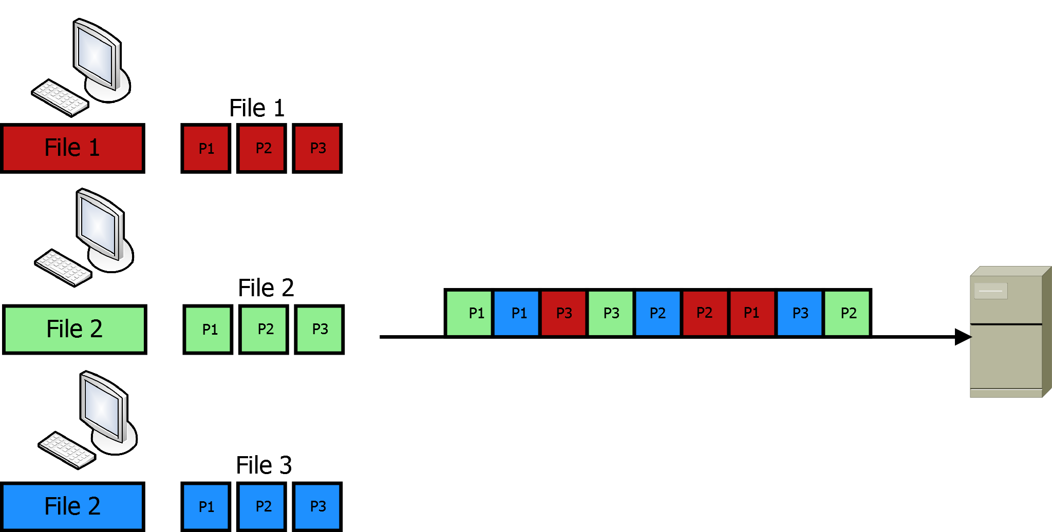
WAN – Packet Switched Networks
Data broken into small chunks - packets
Notes:
Explain: Students should be familiar with packet switching ask them to explain the diagram

Slide 72
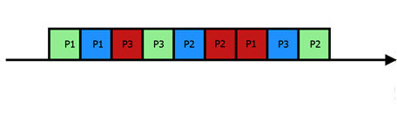
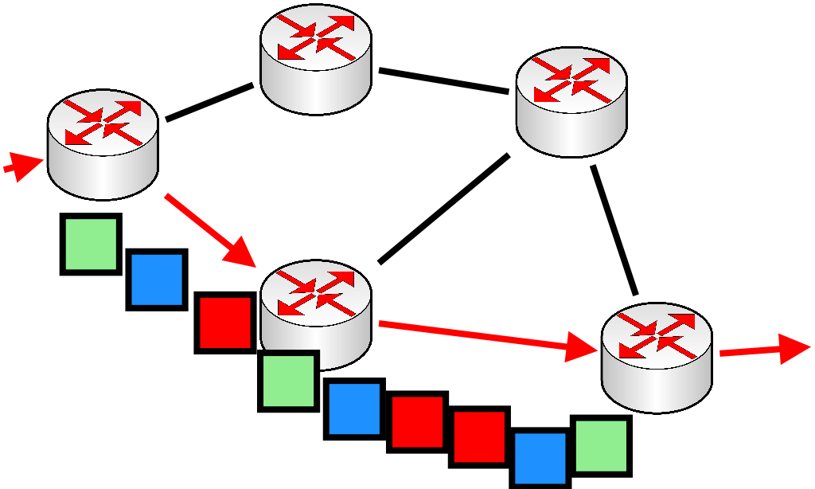
WAN – Packet switched Networks – Virtual Circuit
Virtual Circuit created first (VC)
Data Broken into chunks (Packets)
All chunks follow same path (VC)
Virtual Circuit broken down
ATM / X.25 – use this technique
VC
VC
Notes:
Explain
A virtual circuit is created first, then data from may systems/computers is broken down into chunks (packets). These packets all follow the same route and then the virtual circuit is broken down

Slide 73
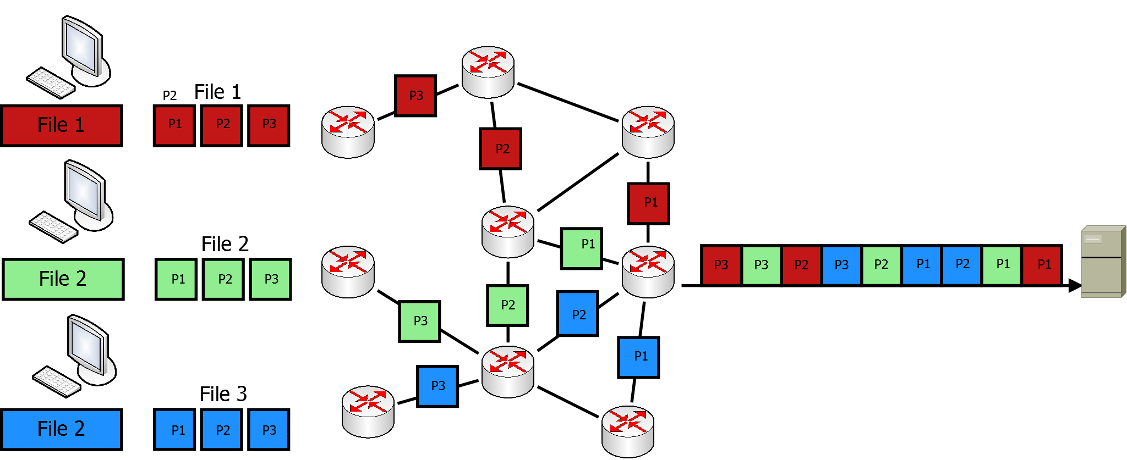
WAN – Packet Switched Networks - Datagram
Each packet sent best route
Each packet can be sent different route (No Virtual Circuit)
Bandwidth shared
Bandwidth cannot be guaranteed
Notes:
Explain: Students should be familiar with packet switching ask them to explain the diagram
Explain – packets may take different routes, even for the same file and the order could be random part 2 arriving before part 1.

Slide 74
Activity – Assignment Question 9
Complete question 9
Notes:
applied

Slide 75
Module 4 - Objectives
Participants can:
Explain features of wide area networks (WANs)
Explain switching and packet techniques used in WANs
Explain how routing is achieved
Discuss the methods used for data communication over PSTN

Slide 76
WAN – Routing – Algorithms
Static
Configured by network administrator
Dynamic
Automatically created by routers
Notes:
Explain

Slide 77
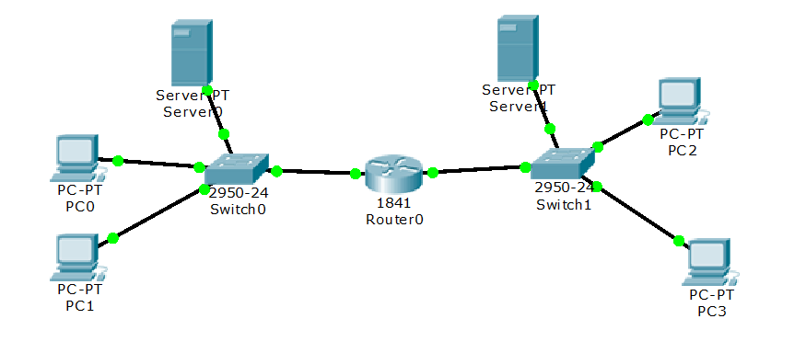
WAN – Routing – Static
Static Routing – Configured by administrator
10.0.0.0
255.255.0.0
10.1.0.0
255.255.0.0
Fa0/0
Fa0/1
ip route 10.0.0.0 255.255.0.0 fa0/0
ip route 10.1.0.0 255.255.0.0 fa0/1
All traffic for 10.0.0.0 network routed/exits via router interface Fa0/0
All traffic for 10.1.0.0 network routed/exits via router interface Fa0/1
Notes:
Explain
Static Routes
Created by administrator
Easy to start with
However when the network changes – more routers manual changes are needed
Complex networks (Internet need dynamic routing)

Slide 78
WAN – Routing – Static
Static Routing
Configured by administrator
Easy to configure
Good for simple networks
Not for large complex networks – have to reconfigure many routers/routes
Does not adapt if there is a failure or network change

Slide 79
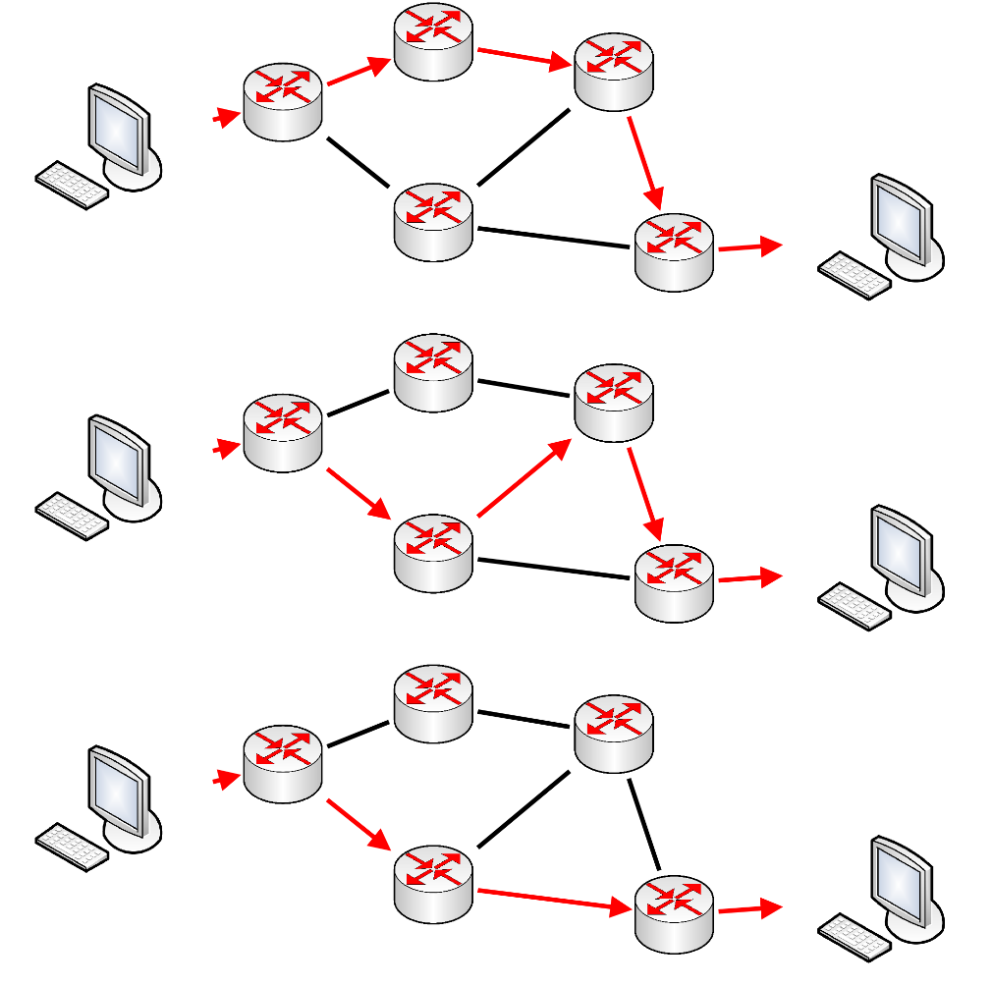

WAN – Dynamic Routing (distance vector)
Distance Vector Routing
Self learns
Based on number of hops
Least hops = best route
Routing Information Protocol (RIP) – uses DVR
Does not adapt to Router failure
Older form of routing
Simple for small networks
4 Hops
4 Hops
3 Hops
Notes:
Explain
Dynamic protocols
Explain RIP is older form of networking. It only uses number of hops and therefor if a router fails the route will not change quickly updates sent node-to-node and may take some time. The process of systems adapting to change is called convergence.
RIP is classful and routing protocol and can only manage standard class A.B,C however RIPv2 can handle variable length masks – this is the protocol that would be used in modern systems

Slide 80
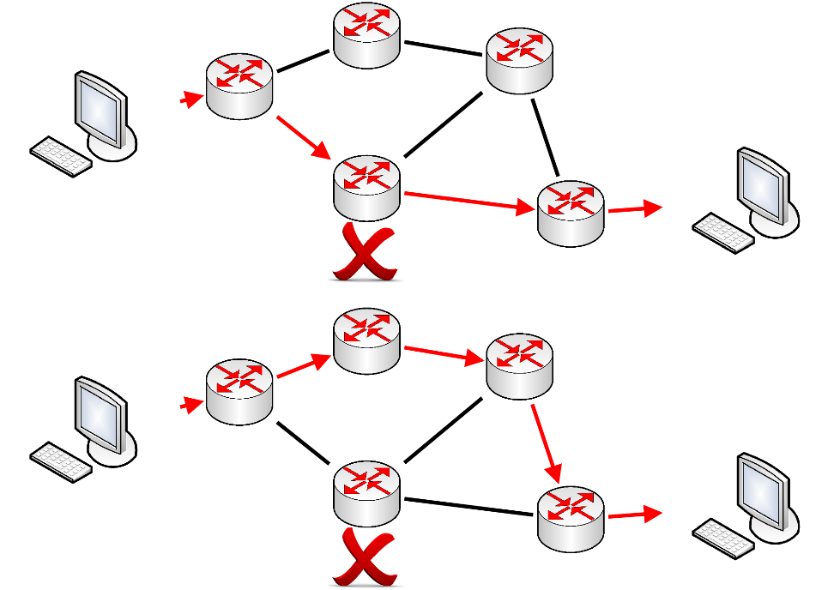
WAN – Dynamic Routing
Link Sate
Calculates based on metric
E.g. link speed
Quickly converges
Adapts to network changes
Better for complex networks
One example Open Shortest Path First (OSPF)
Uses Dijkstra’s Algorithm
Notes:
Explain
Dynamic protocols
Link state calculate metrics such as link speed (instead of number of hops – distance vector)
OSPF is an example if this that uses Dijkstra’s algorithm

Slide 81
Activity – Assignment Question 10
Complete question 10

Slide 82
Module 4 - Objectives
Participants can:
Explain features of wide area networks (WANs)
Explain switching and packet techniques used in WANs
Explain how routing is achieved
Discuss the methods used for data communication over PSTN

Slide 83
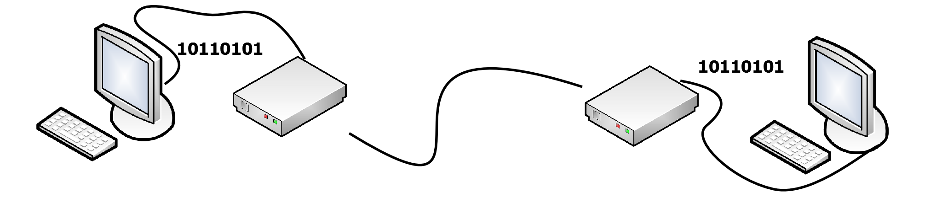
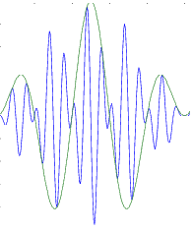
Data communication over PSTN
Public Switched Telephone network (PSTN) –
Also known as Plain-Old-Telephone-Network – POTS
Landline telephones
Analogue (varying voltage)
Computer digital (on/off)
Modem
Modem

Slide 84
Data communication over PSTN
Modems
Modulator/Demodulator
Converts signal
From digital to analogue
Transmits over PSTN
From analogue to digital
Modem
Modem

Slide 85
Data communication over PSTN
Encoding methods
Amplitude Shift Keying (ASK)
Phase Shift Keying (PSK)
Frequency Shift Keying (FSK)
Quadratic Phase Shift (QPSK)
Modem
Modem

Slide 86
Data communication over PSTN
Amplitude Shift Keying (ASK)
1 – Represented by sine wave
0 – No voltage
Can also be two waves of different heights
1
0
1
Notes:
Amplitude Shift Keying (ASK): Uses are carrier electrical signal usually a sine wave. The amplitude of the sine wave is variance to encode the digital signal whist wave frequency and phase are kept constant. In its simplest form 0 is absence of any amplitude and 1 is represented by presence of an amplitude.

Slide 87
Data communication over PSTN
Frequency Shift Keying (FSK)
1 – High frequency
0 – Low frequency
1
0
1
Notes:
Frequency Shift Keying (FSK):
In frequency shift keying two different frequencies of sine waves are used to represent 0 and 1. See below where the distance between the peaks is smaller at the start and hence the frequency higher, representing a 1. A zero is represented by peaks of larger distance and hence a lower frequency

Slide 88
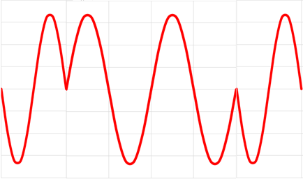
Data communication over PSTN
Phase Shift Keying (PSK)
1 – One phase (180º-360º)
0 – Second Phase (0º-180º)
Sine wave moved left 1/2
1
0
0
1
Notes:
Phase Shift Keying (PSK): Uses a carrier electrical signal however the binary signal is encoded for example with zero representing and unchanged sine wave (see below 0-1 time period). A one is represented by shifting the sine wave by a predefined amount. In the below time periods 1-5 each wave have been shifted half a cycle to the right.

Slide 89
Data communication over PSTN
Quadratic shift keying (QPSK )
Phase shifted by 90º (Right 1/2 wavelength)
Two cycles represent two bits
More efficient
00
01
10
11
Notes:
Quadratic shift keying is a more efficient way of encoding phase shifts. Two bit can be represented by difference amount of phase shift. As in the below where 0 is resented by no phase change, binary 10 represented by a shift of to the left, binary 01 by further shift to the left 90° and so on.

Slide 90
Activity – Assignment Question 11
Complete question 11

